Slide 1
WEEK 3 LECTURES
Overview - Trunking and erlang, Capacity calculation- Improving coverage and capacity
Syllabus Coverage:
Trunking and Grade of Service, Cell splitting, Sectoring, Microcell zone concepts, Umbrella cells (already covered in week 2), Solving Problems
Courtesy:
Rappaport T.S, “Wireless Communications: Principles and Practice”, Pearson education.

Slide 2
Learning Objectives
Concept of Trunking
Key definitions in Trunking /Traffic Theory
Erlang-(unit of traffic)
Grade of Service
Two Types of Trunked Systems
Trunking Efficiency

Slide 3
Trunking & Grade of Service
Cellular radio systems rely on trunking to accommodate a large number of users in a limited radio spectrum.
Trunking allows a large no of users to share a relatively small number of channels in a cell by providing access to each user, on demand, from a pool of available channels.
In a trunked radio system (TRS) each user is allocated a channel on a per call basis, upon termination of the call, the previously occupied channel is immediately returned to the pool of available channels.

Slide 4
Key Definitions
Setup Time: Time required to allocate a radio channel to a requesting user
Blocked Call: Call which cannot be completed at the time of request, due to congestion(lost call)
Holding Time: Average duration of a typical call. Denoted by H(in seconds)
Request Rate: The average number of calls requests per unit time( λ)
Traffic Intensity: Measure of channel time utilization or the average channel occupancy measured in Erlangs. Dimensionless quantity. Denoted by A
Load: Traffic intensity across the entire TRS (Erlangs)

Slide 5
Erlang-a unit of traffic
The fundamentals of trunking theory were developed by Erlang, a Danish mathematician, the unit bears his name.
An Erlang is a unit of telecommunications traffic measurement.
Erlang represents the continuous use of one voice path.
It is used to describe the total traffic volume of one hour
A channel kept busy for one hour is defined as having a load of one Erlang
For example, a radio channel that is occupied for thirty minutes during an hour carries 0.5 Erlangs of traffic
For 1 channel
Min load=0 Erlang (0% time utilization)
Max load=1 Erlang (100% time utilization)

Slide 6
Erlang-a unit of traffic
For example, if a group of 100 users made 30 calls in one hour, and each call had an average call duration(holding time) of 5 minutes, then the number of Erlangs this represents is worked out as follows:
Minutes of traffic in the hour = number of calls x duration
Minutes of traffic in the hour = 30 x 5 = 150
Hours of traffic in the hour = 150 / 60 = 2.5
Traffic Intensity= 2.5 Erlangs

Slide 7
Traffic Concepts
Traffic Intensity offered by each user(Au): Equals average call arrival rate multiplied by the holding time(service time)
Au=λH(Erlangs)
Total Offered Traffic Intensity for a system of U users (A):
A =U*Au(Erlangs)
Traffic Intensity per channel, in a C channel trunked system
Ac=U*Au/C(Erlangs)

Slide 8
Trunking & Grade of Service
In a TRS, when a particular user requests service and all the available radio channels are already in use , the user is blocked or denied access to the system. In some systems a queue may be used to hold the requesting users until a channel becomes available.
Trunking systems must be designed carefully in order to ensure that there is a low likelihood that a user will be blocked or denied access.
The likelihood that a call is blocked, or the likelihood that a call experiences a delay greater than a certain queuing time is called “Grade of Service” (GOS)’’.

Slide 9
Trunking & Grade of Service
Grade of Service (GOS): Measure of ability of a user to access a trunked system during the busiest hour. Measure of the congestion which is specified as a probability.
The probability of a call being blocked
Blocked calls cleared(BCC) or Lost Call Cleared(LCC) or Erlang B systems
The probability of a call being delayed beyond a certain amount of time before being granted access
Blocked call delayed or Lost Call Delayed(LCD) or Erlang C systems

Slide 10
Blocked Call Cleared Systems
When a user requests service, there is a minimal call set-up time and the user is given immediate access to a channel if one is available
If channels are already in use and no new channels are available, call is blocked without access to the system
The user does not receive service, but is free to try again later
All blocked calls are instantly returned to the user pool

Slide 11

Modeling of BCC Systems
Erlang B formula is given by
where C is the number of trunked channels offered by a trunked radio system and A is the total offered traffic.
Pr[blocking]= (A^{C}/C ! )

Slide 12
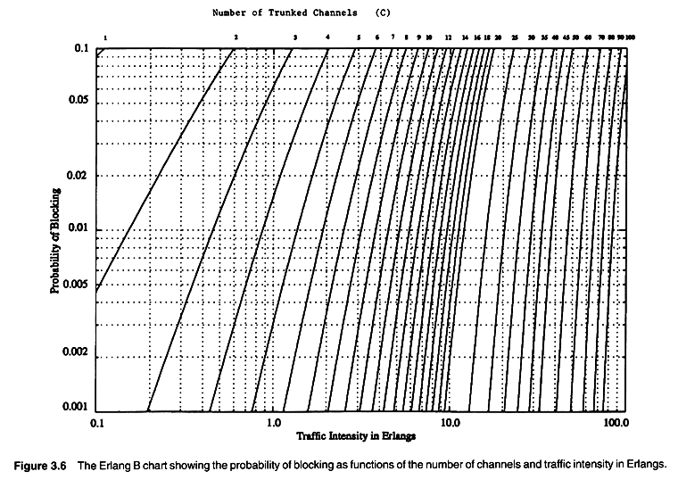
Erlang B
Source : Wireless Communications: Principles and Practice, Theodore S. Rappaport, pp 81.

Slide 13
Example 3.4
How many users can be supported for 0.5% blocking probability for the following number of trunked channels in a BCC system? (a) 5, (b) 10,(c)=20. Assumed that each user generates 0.1 Erlangs of traffic.
Solution
Given C=5, GOS=0.005, Au=0.1,
From graph/Table using C=5 and GOS=0.005,A=1.13
Total Number of users U=A/Au=1.13/0.1=11 users
Given C=10, GOS=0.005, Au=0.1,
From graph/Table using C=5 and GOS=0.005,A=3.96
Total Number of users U=A/Au=3.96/0.1=39 users
Given C=20, GOS=0.005, Au=0.1,
From graph/Table using C=20 and GOS=0.005,A=11.10
Total Number of users U=A/Au=11.10/0.1=110 users

Slide 14
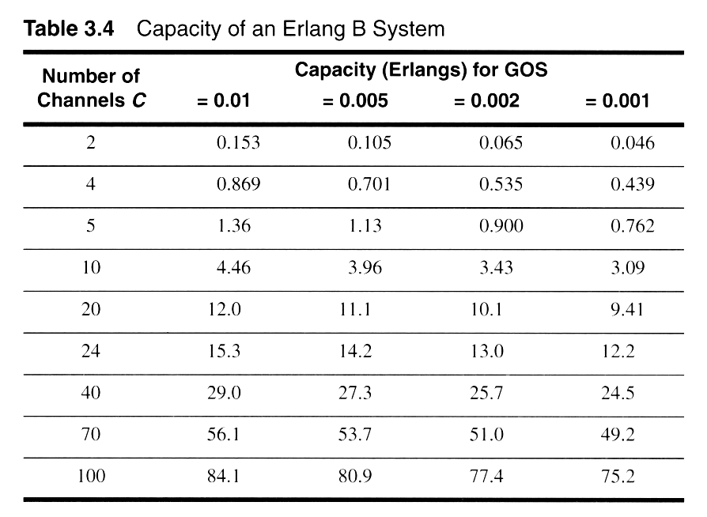
Erlang B Trunking GOS
Source : Wireless Communications: Principles and Practice, Theodore S. Rappaport, pp 79.

Slide 15
BCC System Example
Assuming that each user in a system generates a traffic intensity of 0.2 Erlangs, how many users can be supported for 0.1% probability of blocking in an Erlang B system for a number of trunked channels equal to 60.
Solution 1:
System is an Erlang B
Au = 0.2 Erlangs
Pr [Blocking] = 0.001
C = 60 Channels
From the Erlang B figure, we see that
A ≈ 40 Erlangs
Therefore U=A/Au=40/0.02=2000users.

Slide 16
Blocked Call Delayed(BCD) Systems
Queues are used to hold call requests that are initially blocked
When a user attempts a call and a channel is not immediately available, the call request may be delayed until a channel becomes available
Mathematical modeling of such systems is done by Erlang C formula
The Erlang C model is based on following assumptions :
Similar to those of Erlang B
Additionally, if offered call cannot be assigned a channel, it is placed in a queue of infinite length
Each call is then serviced in the order of its arrival

Slide 17

Blocked Call Delayed Systems
Erlang C formula which gives likelihood of a call not having immediate access to a channel (all channels are already in use)

Slide 18
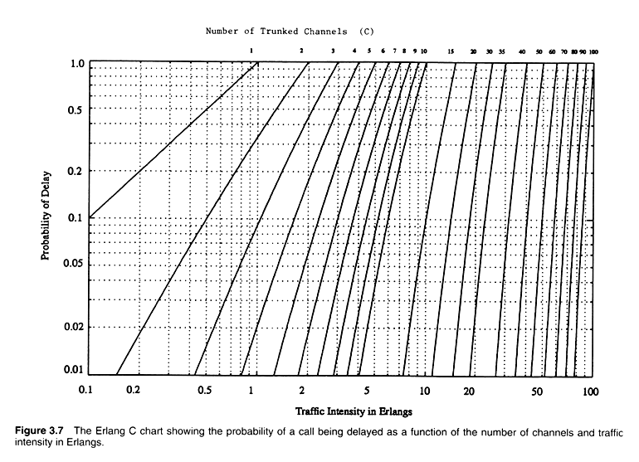
Erlang C
=
Source : Wireless Communications: Principles and Practice, Theodore S. Rappaport, pp 82.

Slide 19
Trunking Efficiency
Trunking efficiency is a measure of the number of users which can be offered a particular GOS with a particular configuration of fixed channels.
The way in which channels are grouped can substantially alter the number of users handled by a trunked system.
Example:
10 trunked channels at a GOS of 0.01 can support 4.46 Erlangs, where as two groups of 5 trunked channels can support 2x1.36=2.72 Erlangs of traffic
10 trunked channels can offer 60% more traffic at a specific GOS than two 5 channel trunks.
Therefore, if in a certain situation we sub-divide the total channels in a cell into smaller channel groups then the total carried traffic will reduce with increasing number of groups

Slide 20
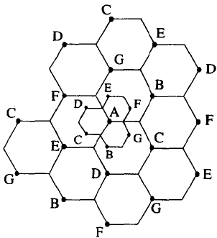
Improving Coverage & Capacity in Cellular system
As number of users increases, number of channel assigned to a cell become insufficient to support large number of users. Therefore Cellular design techniques are required.
The cellular design techniques which are required to provide more channels per unit coverage area are:
1) Cell Splitting
2) Sectoring
3) Microcell Zone Concept
1) Cell Splitting :
The process of subdividing a congested cell into smaller
cells, each with its own base station & a corresponding
reduction in antenna height & transmitted power.
Cell splitting Reduces the transmitted power.
The original base station A is surrounded by 6 new microcell.
The smallest cells are added as to preserve the frequency reuse plan. Now G is placed halfway b/w the 2 larger stations utilizing same channel set G.
Cell splitting increases the capacity of a cellular system:
It increases the number of times that channel are reused. By defining new cells which have a smaller radius than original cells & by installing smaller cell.
Due to additional number of channels per unit area.
Figure Source : Wireless Communications: Principles and Practice, Theodore S. Rappaport, pp 87.

Slide 21
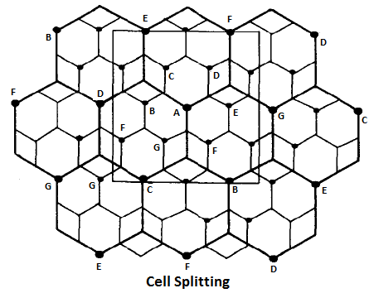
Improving Coverage & Capacity in Cellular system
Area of bigger cell = A _{o} = πR²
Area of smaller cell = A_{N} = π (R/2)² = πR²/4
4 A_{N} = A _{o} or A_{N} = A _{o} /4
Therefore New Area is ¼ of the older area.
Source : Wireless Communications: Principles and Practice, Theodore S. Rappaport, pp 89.

Slide 22
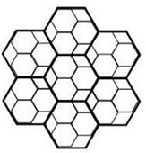
Improving Coverage & Capacity in Cellular system
As New Area is ¼ of the older area (now one bigger cell include approximately 4 smaller cell), therefore the capacity of system is increased by 4 times.
Before Cell splitting :
Total BW available = 25MHz
Each user Required = 25kHz
Therefore
1 Antenna can serve = 25MHz / 25kHz = 1000 user.
After Cell Splitting :
As older area is 4 times the newer area. i.e. we have now
4 new area = 1 older area
For one new area,🡪
Total BW available = 25MHz
Each user Required = 25kHz
Therefore 1 Area can serve = 25MHz / 25kHz = 1000 user.
Therefore 4 Area can serve = 1000 * 4 = 4000 user.
i.e. Capacity is increased by 4 times, due to cell splitting.

Slide 23
Improving Coverage & Capacity in Cellular system
let P_{t1} ( Transmit Power at old cell boundaries)
let P_{t2} ( Transmit Power at new cell boundaries)
let P_{r1} (Required Power at old cell boundaries)
let P_{r2} (Required Power at new cell boundaries)
n is the path loss exponent.
P_{r1} = P_{t1} (R) ^{-n}
P_{r2} = P_{t2} (R/2) ^{-n}
As frequency reuse plan for new microcells behave exactly as the original cells.
Therefore P_{r1} = P_{r2}
Therefore P_{t1} (R) ^{–n} = P_{t2} (R/2) ^{-n}
P_{t1} / P_{t2} = (1/2) ^{-n}
Taking log both side
10 log₁₀ (P_{t1} / P_{t2}) = n10 log₁₀(2) = 3n
For n = 4, P_{t1} / P_{t2} = 12 dB
i.e. Transmitted Power is reduced by 12 dB with newer cell.

Slide 24
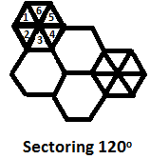
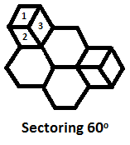
Improving Coverage & Capacity in Cellular system
2) Sectoring :
The technique for decreasing the co-channel interference & thus increasing the system performance by using directional antenna is known as Sectoring .
Sectoring Can be done at 60º & 120⁰ .
Co-channel Interference in a cellular system may be decreased by replacing a single Omni directional antenna at the base station by several directional antenna, each radiating with in a specific sector.
Sectoring- 60º
Sectoring- 120º
Source : Wireless Communications: Principles and Practice, Theodore S. Rappaport, pp 90.

Slide 25
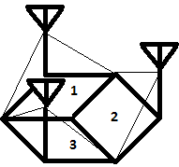
Improving Coverage & Capacity in Cellular system
Antenna changed from Omni directional to Directional.
Antenna are not placed near to each other, otherwise adjacent channel interference get increased.
By cell splitting,:
it increase the number of channels & this
is achieved by decreasing the cell radius
R & keeping Co-channel reuse ratio D/R
constant.
it increase the number of channels & this
is achieved by keeping R constant & D/R decreased.
Sectoring increases the S/I (signal to interference) ratio by using direction antenna so that cluster size may be reduced.
Capacity improvement is achieved by reducing the number of cells in a cluster, thus increase the frequency reuse.
To do all this, we have to reduce interference without decreasing the transmit power.

Slide 26
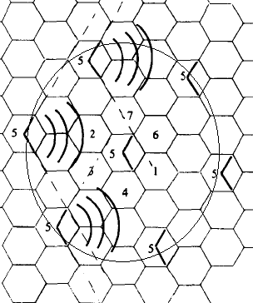
Improving Coverage & Capacity in Cellular system
When sectoring is employed,
the channels used in a particular
Cell are broken down into sectored
groups & are used only with in a
Particular sector.
Assuming N=7 for the case 120º
Sector. The number of interference
In the first tier is reduced from 6 to 2.
This is because only 2 of 6 co-channel
Cells receive interference with a
Particular sectored group as shown.
Out of 6 co-channel cells, 3 are on
Right & 3 are on Left of middle cell.
With Omni directional antenna due to
Presence of 6 cells, they can interfere (in tier) with middle 5th block.
Now, only 2 antenna will interfere with the middle one, so the number is reduced to 2 from 6.
Source : Wireless Communications: Principles and Practice, Theodore S. Rappaport, pp 91.

Slide 27
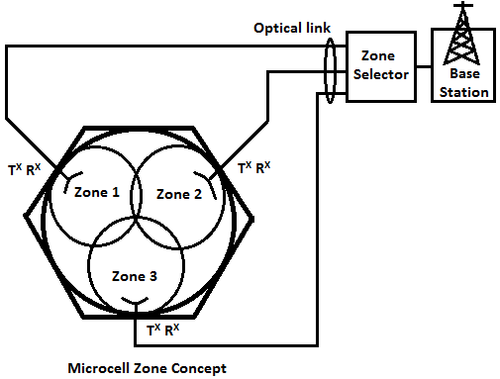
Improving Coverage & Capacity in Cellular system
3) Microcell Zone Concept :
Problem with sectoring 🡪
Even inside a cell, handoff is required.
Load on the MSC increased.
To overcome
this problem,
we divide the
cell into further
2-3 zones. This
technique is
known as Micro-
cell Zone Concept.
This concept is
introduced by
LEE.
Source : Wireless Communications: Principles and Practice, Theodore S. Rappaport, pp 95.

Slide 28
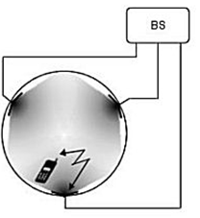
Improving Coverage & Capacity in Cellular system
Construction : Each of 3 or more zone sites are connected to a single base station & share the same radio equipment (Base Station)as shown in figure.
Zones are connected by coaxial cable, fiber optic cable or microwave link to the base station.
Multiple zones & a single base station Make up a cell.
Operation : A mobile with in a cell, is served by
the zone with the strongest signal.
This approach is superior to sectoring
since antennas are placed on the edges of
the cell & any BS channel may be assigned
to any zone by the base station.
As mobile travels from one zone to another
within the cell, it retains the same channel.
Unlike in sectoring, handoff is not required
at the MSC when the mobile travels b/w zones
within the cell.

